Slide 1
Personal Health Management System
“PerHMS”
Todd Rosenkrantz
Khalid Alotaibi
Brett Birth

Slide 2
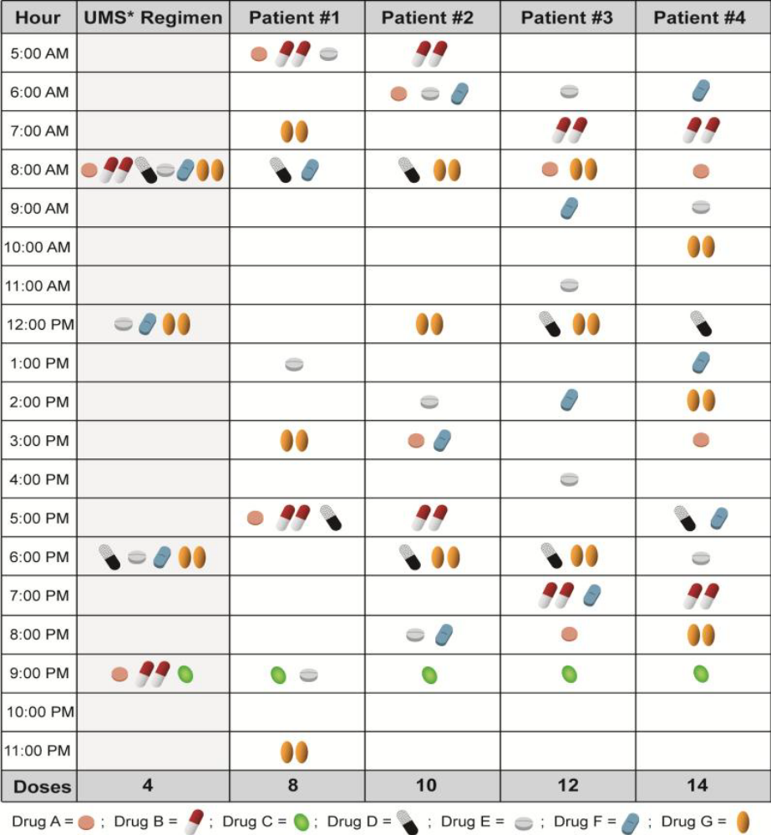

Current Situation
Confusing
  Multiple sources
  Multiple Instructions
Complicated
  Multiple Medications
  Before/After/With Food?
  Different Doctors
  Different Pharmacies

Slide 3
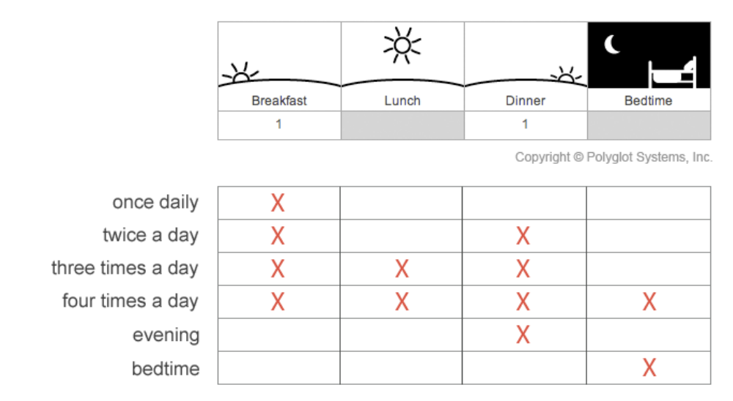
UMS (Universal Medication Schedule)
Solution
  Develop an application that takes various information and creates a UMS
  Provide Reminders
  Keep Caregivers informed
  Unified location for medical data
  Track various vital signs

Slide 4
Design Process
Define the Problem
  What Exactly are we trying to achieve?
Define the Target
  Who will use the Solution
Define the Environment
  Understand what is required to use the solution
Understand Constraints
  Domain Knowledge Limitations
  Experience Limitations
  Development Environment Limitations

Slide 5
Incremental development
A hybrid model where the software specification, design, implementation, and testing is broken down into a series of increments which are developed and delivered
Requirement Specification = Sum (R1, R2, R3,…)
R1
Design
Coding
Testing
R2
Design
Coding
Testing
R3
Design
Coding
Testing
Cont’d….
Notes:
Financial market example: Release News application, then Buy/sell Funds, buy sell stocks, options, etc.

Slide 6
Development Environment
Application developed on PC
  Using the Android SDK
  Programmed mostly in Java
Made use of VisualStudio.com Git Repository
  Online repository that allows us to share our code easily
  Prevents us from accidently overwriting each other’s work

Slide 7
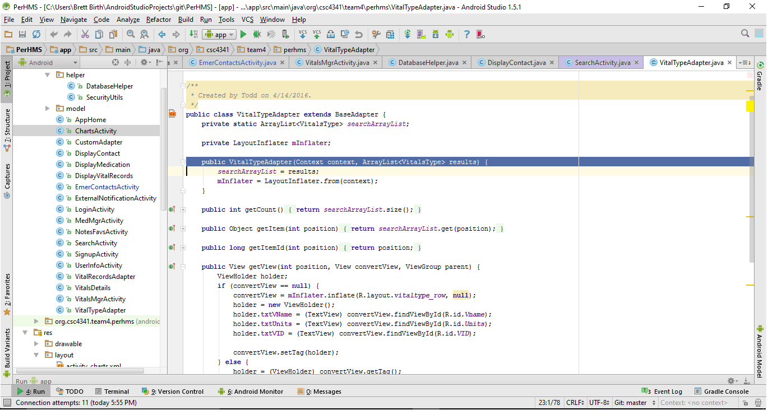
Android Studio Developer Kit (SDK)
-Development environment
-Includes many tools and libraries to aid in design
-Includes an emulator for testing.
Android Studio is the official IDE (integrated development environment ) for Android development.
Cont’d….

Slide 8
Demonstration

Slide 9
Summary
Target user
  Elderly
  Family member/caregiver
Target platform – Android
Simplify Medication Schedules
Unified Personal Medical Repository

Slide 10
Thank You!
Questions?

